Slide 1

Email
Pattern Analytics
by:
Maarten
Steven
Robin

Slide 2

Challenge
Notes:
Communication is essential for business. Can we detect emotions and mood from emails? Can we detect emerging topics and trends?

Slide 3

Data
Notes:
Unique treasure trove of emails

Slide 4
Traffic volume
Email traffic volume
hour/day/week/month/year
Notes:
Traffic volume is a relatively non-invasive way to monitor day-to-day business activity, which we can then compare over time.
But we wouldn’t recommend using this as a performance metric for individual staff, as this would encourage the smarter staff to send more emails.
And every sent email, creates reading/processing time for the recipient.
But it doesn’t tell us how useful these emails.

Slide 5
Sent and Received

Slide 6

Reading-time
Email attachments

Slide 7
Readability
Notes:
Readability is important especially when working in an international team.
Low readibility score, may just be indication of complex subjects being discussed,
it could be an indicator of poor written communication skills,
so staff may benefit from extra training.

Slide 8
Response time

Slide 9

Questions
Notes:
How many questions are asked each day, week, year?
How long does it take for a reply to an email with a question?

Slide 10
Out of hours emails
Notes:
An increase in outgoing mail out of hours could indicate teams are stretched and more staff are needed.
Or it could indicate staff member who’s productivity is suffering during the day,
which perhaps should be investigated further to look after staff well-being.

Slide 11
Inappropriate emails
Notes:
It is also possible to scan for inappropriate emails.
For example, emails which contain profanity or sexual comments.
We can also look for patterns or groups of employees or teams where inappropriate emails are exchanged.
Potentially you could organise staff training to try to improve the situation.

Slide 12
Attachments
Encourage staff to use cloud Helps version control, saves times & storage space.

Slide 13
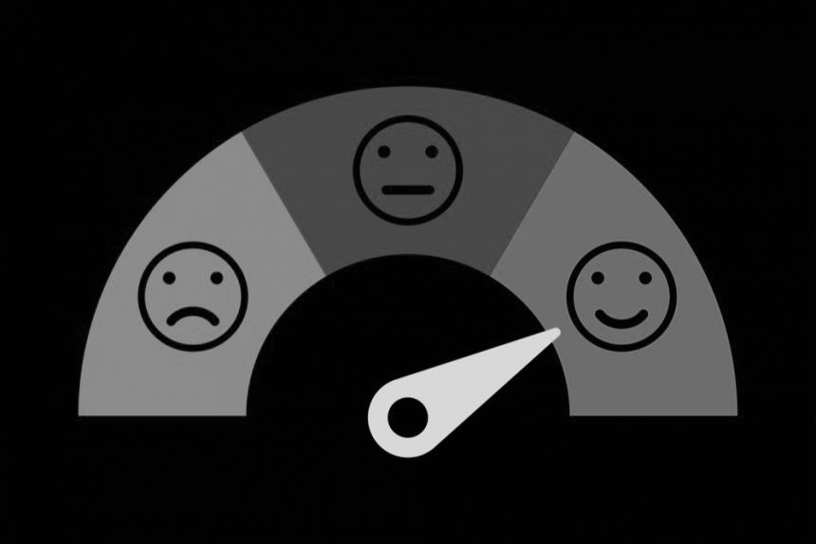
Sentiment trends
Notes:
Next we looked at sentiment trends.
This is based on text analysis of the emails.
We use a large corpus of words, associated with different sentiments.
And we checked to see what was the frequency of words in each email associated with specific sentiments.
It gives an interesting view of the oversentiment in the company and how it changes over time.
Usually sentiment analysis is used by marketers to assess how people feel about their products.
But here it could be used as an insight into staff wellbeing and morale.
An important cavet while interpreting sentiment analysis is the source of the corpus, in this case the corpuswas actually based on movie reviews.
But you could test the validity of your sentiment analysis inhouse, by asking staff to complete questionnaires on their moods and compare the results.

Slide 14
Sentiments of new employees
Notes:
We also looked at the sentiments of new employees.
Was there any unusual outliers in the first month of employment?
Perhaps, less positive sentiments in the first week could indicate more needs to be done to help with employee onboarding.

Slide 15
Predicting when an employee will leave
Notes:
Next we looked at whether we could predict employee churn.
We assume an employee left the company at the date they stopped sending emails.
To make a model, first we calculated some features, a lot of features.
Then we filtered these features for potential predictors and trained a classifier model.
We tried a few approaches.
The best model we found used …..randomforest/svn/decisiontrees.
---> possibility the model may only be useful for predicting when a subset of employees will leave.
Not everyone leaves on bad terms, so you would need more information about why the employees left the firm, for example they may have been offered a higher salary or improved conditions.
It would also be worthwhile to look at whether there was any change in social networks in the weeks prior to leaving.

Slide 16
Topic analysis
Notes:
The emails are a goldmine of words for topic analysis.
We can see what topics are trending company-wide.

Slide 17
Social networks - who talks to who?
Notes:
Social network analysis can give use an insight into relationships within the company.

Slide 18
Fraud Analytics
Perhaps just some investigative tools?
Search topic, return beautiful spacy visualisation (just highlights named entities but looks nice).

Slide 19

Deployment
Notes:
Brief walk through streamlit

Slide 20
Pitfalls
Multiple email clients
Personal email accounts
Notes:
What we learnt = a lot

Slide 21
Future improvements
Real-time pattern detection == proactive vs. reactive
More data-sources - slack channel
Validate metrics

Slide 22
Hire us
Notes:
I want to finish by saying
HIRE US
Maarten is a first class coder
Stephen is a master of machine learning algorithms
Robin is a creative thinker.
I hope you enjoyed our presentation

Slide 23
Thanks for listening

